Slide 1




AtliQ
Mart
ABOUT PROJECT
AtliQ Mart is a retail giant with over 50 supermarkets in the southern region of India. All their 50 stores ran a massive promotion during the Diwali 2023 and Sankranti 2024 (festive time in India) on their AtliQ branded products. Now the sales director wants to understand which promotions did well and which did not so that they can make informed decisions for their next promotional period.

Slide 2
AtliQ
Mart
AtliQ Mart Promotion: Sales Analysis
Presented By: Pavani Bachina
Presented To: Sales Director

Slide 3
AtliQ
Mart
Agenda
1 | Data Overview
2 | MySQL Queries
3 | Dashboards Overview
4 | Insights

Slide 4
DATA OVERVIEW
Brief overview of the datasets provided. Dataset consists of 3 dimensional tables: Campaigns, Products, and Stores. Events is fact table in the dataset.

Slide 5
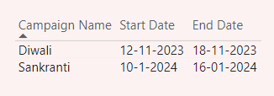
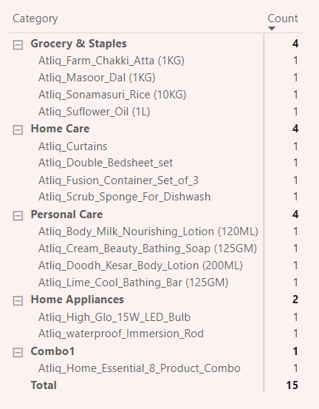
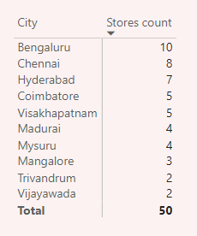
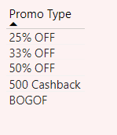
Data Overview
AtliQ
Mart
Campaign Type and their duration
Category and Products
City and Store Count
Types of Promo

Slide 6
MYSQL QUERIES
Brief overview of the ad hoc requests.

Slide 7
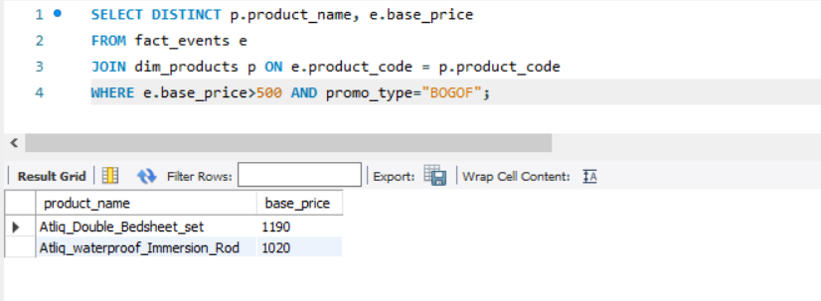
AtliQ
Mart
Provide a list of products with a base price greater than 500 and that are featured in promo type of 'BOGOF' (Buy One Get One Free).

Slide 8
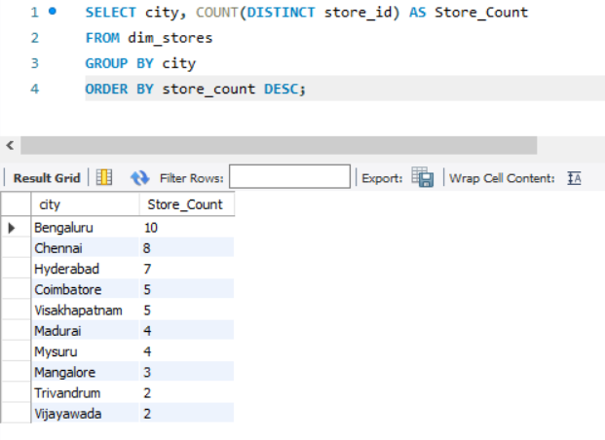
AtliQ
Mart
2. Generate a report that provides an overview of the number of stores in each city.

Slide 9
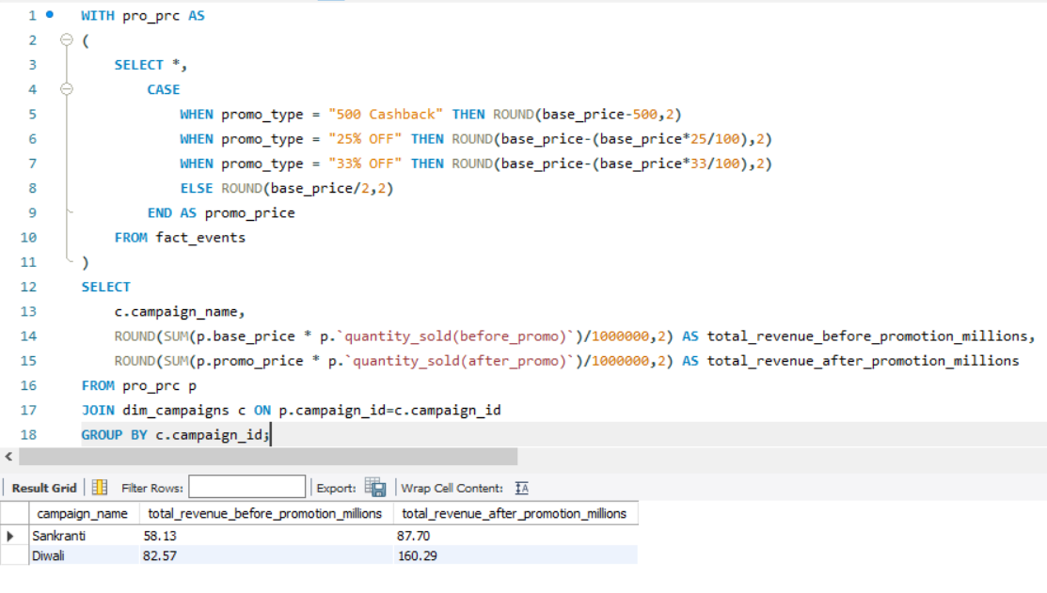
AtliQ
Mart
3. Generate a report that displays each campaign along with the total revenue generated before and after the campaign?

Slide 10
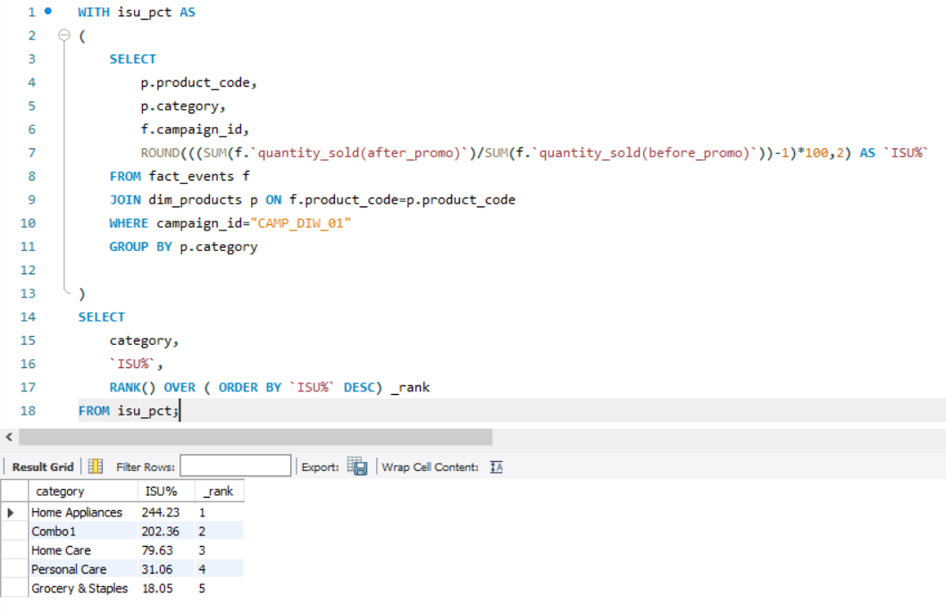
AtliQ
Mart
4. Produce a report that calculates the Incremental Sold Quantity (ISU%) for each category during the Diwali campaign.

Slide 11
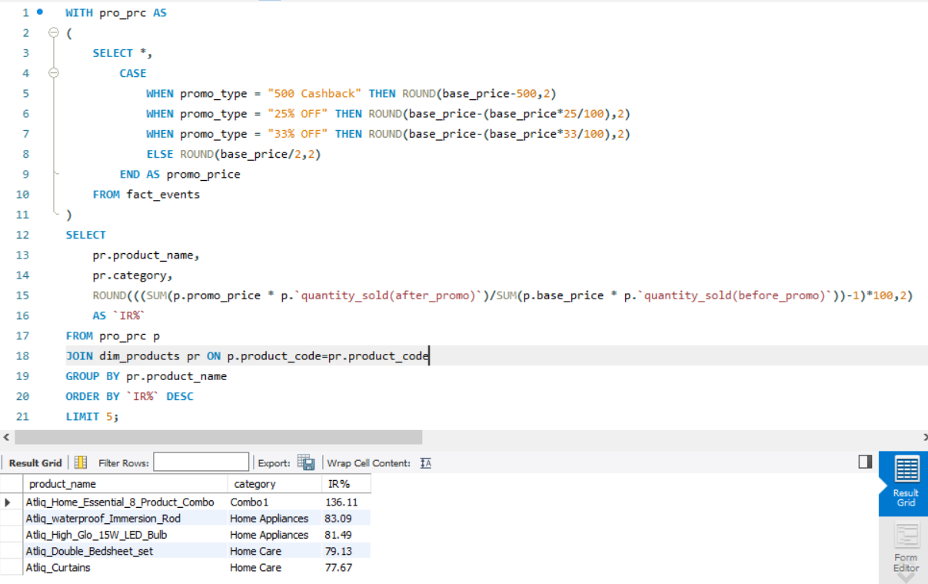
AtliQ
Mart
5. Create a report featuring the Top 5 products, ranked by Incremental Revenue Percentage (IR%), across all campaigns.

Slide 12
DASHBOARD OVERVIEW
Overview of the designed dashboard including how to use, key metrics and insights.

Slide 13

AtliQ
Mart
Dashboard Overview Timeline
Dashboard
Store Performance
Promotion Type Analysis
Product & Category Analysis

Slide 14
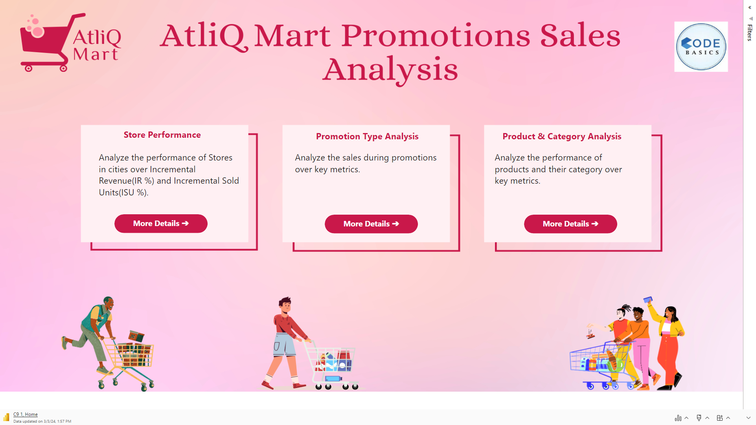
AtliQ
Mart

Slide 15
AtliQ
Mart
STORE PERFORMANCE
Brief analysis of the store performance based on quantity sold, revenue generated, ISU% and IR%.

Slide 16
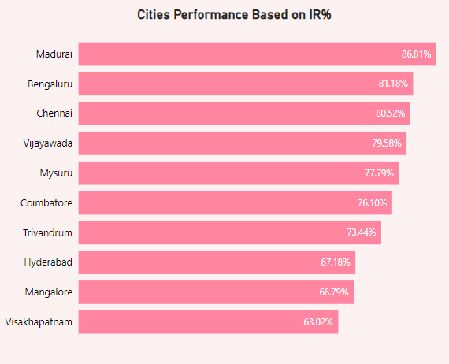
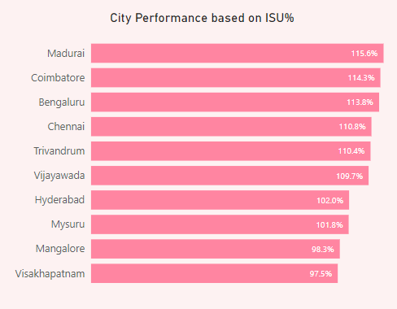
AtliQ
Mart
Madurai boasts the highest IR% among all regions, reaching an impressive 86.81%. Additionally, Madurai demonstrates exceptional ISU% at 115.6%.
Bengaluru, Chennai, and Vijayawada exhibit substantial IR% rates, each hovering around 80%.
Coimbatore emerges with the second-highest ISU% rate at 114%. Bengaluru follows closely behind with an ISU% of 113.8%, while Chennai maintains a notable ISU% rate of 111%.

Slide 17
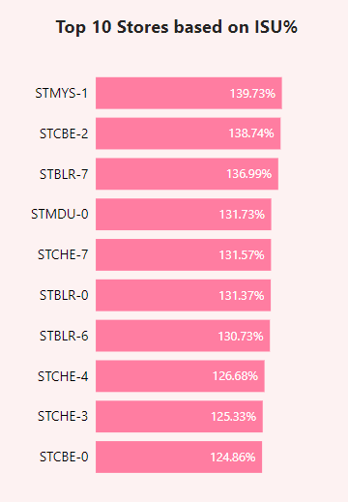
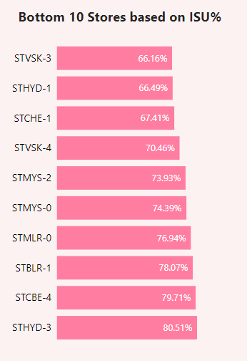
AtliQ
Mart
Mysuru store stands out with the highest ISU% among all stores, boasting an impressive rate of 139.7%. Following closely behind are Coimbatore and Bangalore stores, with ISU% values of 138.7% and 137%, respectively.
Among the 10 stores analyzed, there is notable variation in the distribution: 1 Madurai Store, 2 Coimbatore Stores, 1 Madurai Store, 3 Chennai Stores, and 3 Bangalore Stores.
On the contrary, Vishakhapatnam and Hyderabad record the lowest ISU% values at 66%, while Chennai demonstrates a slightly higher ISU% of 67%.
Among the bottom-performing stores, there is a diverse representation: 2 Vishakhapatnam Stores, 2 Hyderabad Stores, 1 Chennai Store, 2 Mysuru Stores, 1 Mangalore Store, 1 Coimbatore Store, and 1 Bangalore Store.

Slide 18
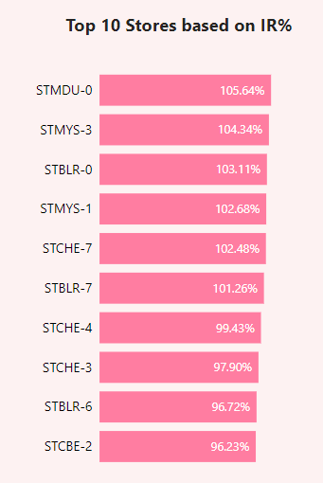
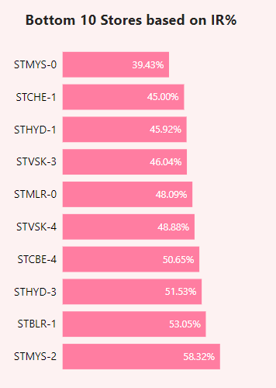
AtliQ
Mart
Madurai store leads with the highest IR%, achieving a remarkable rate of 106%. Following closely behind are Mysuru and Bangalore stores, with IR% values of 104% and 103%, respectively.
Among the 10 stores analyzed, there is a varied distribution: 1 Madurai Store, 1 Coimbatore Store, 2 Mysuru Stores, 3 Chennai Stores, and 3 Bangalore Stores.
On the other end of the spectrum, Mysuru Store records the lowest IR% at 39.4%, with Chennai and Hyderabad Stores trailing closely behind with IR% values of 45% and 46%, respectively.
Among the bottom-performing stores, there is a diverse representation: 2 Vishakhapatnam Stores, 2 Hyderabad Stores, 1 Chennai Store, 2 Mysuru Stores, 1 Mangalore Store, 1 Coimbatore Store, and 1 Bangalore Store.

Slide 19
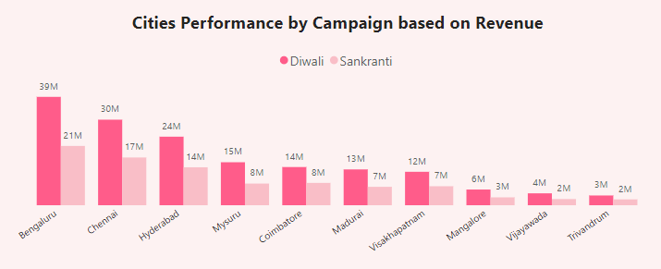
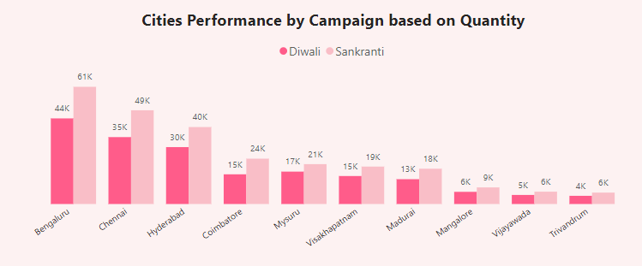
AtliQ
Mart
Diwali promotions have proven to be more lucrative in terms of generating incremental revenue compared to Sankranti promotions.
Conversely, Sankranti promotions have resulted in a higher quantity of products sold compared to Diwali promotions.
Regions such as Bengaluru, Chennai, and Hyderabad have demonstrated strong performance in both revenue generation and sold units.
In contrast, regions including Mangalore, Vijayawada, and Trivandrum have experienced subpar performance in both revenue and sold units.

Slide 20
AtliQ
Mart
PROMOTION TYPE ANALYSIS
Brief analysis of the promotion type analysis categorized by campaign and promo type.

Slide 21
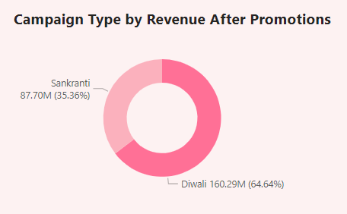
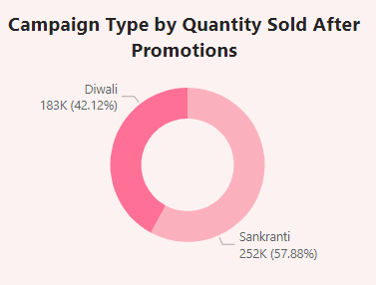
AtliQ
Mart
Sankranti promotions have sold a higher quantity of products compared to Diwali promotions.
However, despite selling fewer units, Diwali promotions have generated more revenue than Sankranti promotions.
Specifically, approximately 67% of the total revenue, equivalent to around 160.3 million, is attributed to Diwali promotions.
On the other hand, Sankranti promotions account for approximately 58% of the total quantity sold.

Slide 22
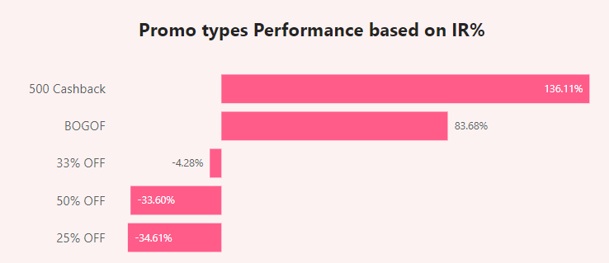
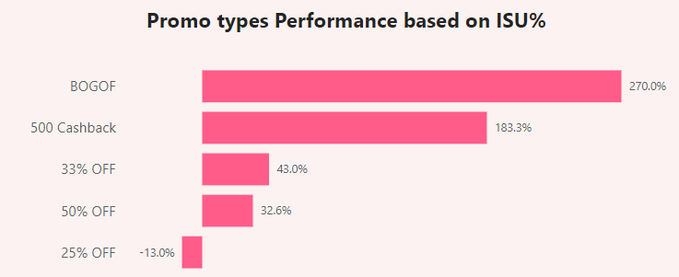
AtliQ
Mart
The top 2 promotional types based on IR% are "500 Cashback" with a remarkable 136% and "BOGOF" (Buy One Get One Free) with 84%.
Conversely, the bottom 2 promotional types based on IR% are "50% OFF" with a negative IR% of -34% and "25% OFF" with a negative IR% of -35%.
When considering ISU%, the top 2 promotional types are "BOGOF" with an impressive ISU% of 270% and "500 Cashback" with an ISU% of 183%.
On the other hand, the bottom 2 promotional types based on ISU% are "50% OFF" with a modest ISU% of 32% and "25% OFF" with a negative ISU% of -13%

Slide 23
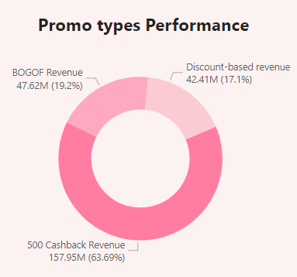
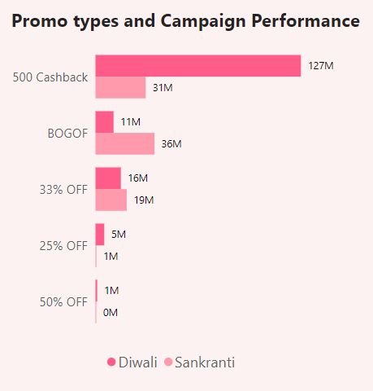
AtliQ
Mart
The revenue generated through discount-based promotions, include 25% OFF, 33% OFF, and 50% OFF revenues.
Among the promotional types, "500 Cashback" stands out as the top performer, contributing to 64% of the total revenue generated after promotions. Following closely behind is "BOGOF" (Buy One Get One Free) with approximately 19% of the revenue.
During Diwali promotions, "500 Cashback" performed exceptionally well, contributing to a substantial revenue of 127 million. Additionally, "25% OFF" and "50% OFF" promo types also demonstrated strong performance during Diwali.
Conversely, "BOGOF" and "33% OFF" promo types excelled during Sankranti promotions, generating revenue of 36 million and 19 million, respectively.

Slide 24
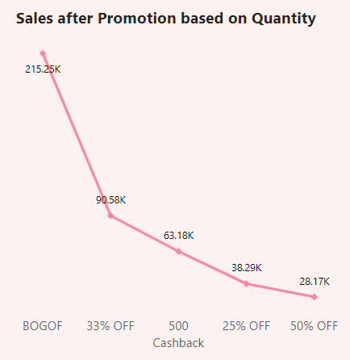
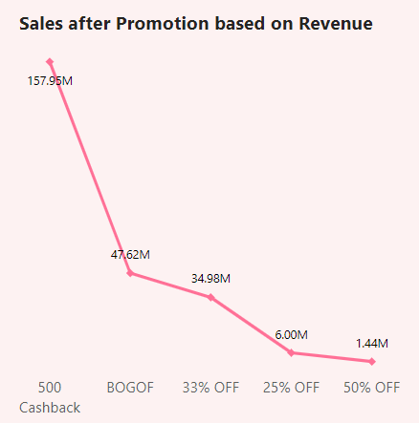
AtliQ
Mart
Among the promotional types, "BOGOF" (Buy One Get One Free) stands out as the top performer in terms of quantity sold after promotions, with a total of 215K units. Following closely behind are "33% Off" and "500 Cashback" promo types.
In terms of revenue generated after promotions, "500 Cashback" emerges as the leading promotional type, generating the highest revenue of 158 million. "BOGOF" and "33% OFF" also contribute significantly to revenue after promotions

Slide 25
AtliQ
Mart
PRODUCT & CATEGORY ANALYSIS
Brief analysis of the product and category sales comparison based on quantity sold, revenue generated, ISU% and IR%.

Slide 26
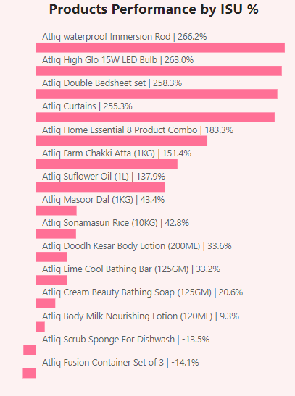
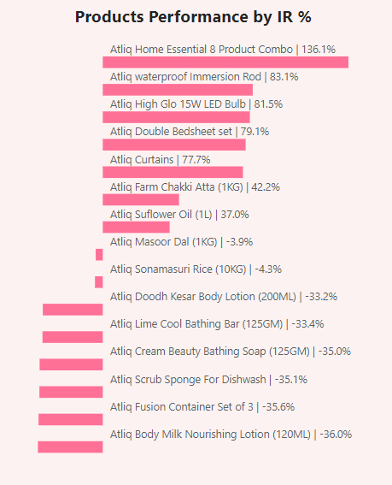
AtliQ
Mart
Among the products, the Waterproof Immersion Rod emerges as the top performer in terms of ISU%, with an impressive ISU% of 266%. This is followed closely by the High Glow 15W LED Bulb (263%), Double Bedsheet Set (258%), and Curtains (255%).
Conversely, the products with the lowest ISU% are the Scrub Sponge for Dishwash (-13.5%) and Fusion Container Set of 3 (-14%).
In terms of IR%, the Home Essential 8 Product Combo leads with the highest IR% of 136%. The Waterproof Immersion Rod follows with an IR% of 83%, while the High Glow 15W LED Bulb has an IR% of 82%.
Notably, the Fusion Container Set exhibits the lowest IR% at -35.6%, and the Body Milk Nourishing Lotion follows closely behind with an IR% of -36%.

Slide 27
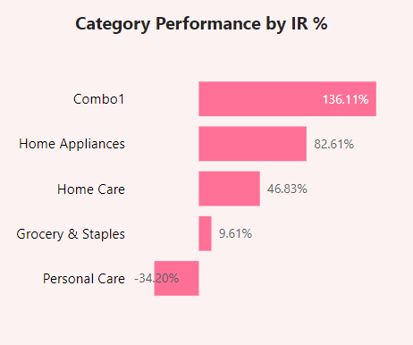
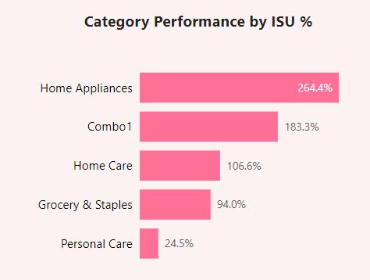
AtliQ
Mart
Combo 1 emerges as the top performer in terms of Incremental Revenue Percentage (IR%), while Home Appliances demonstrate the highest Incremental Sold Units Percentage (ISU%).
Home Appliances also exhibit strong performance in terms of IR%, securing the second-highest IR% at 83%. Conversely, Personal Care has the lowest IR% at -34%.
In terms of ISU%, Home Appliances maintain their lead by securing the second-highest ISU% at 183%, while Combo 1 follows closely behind with 183%. Personal Care records the lowest ISU% at 25%.

Slide 28
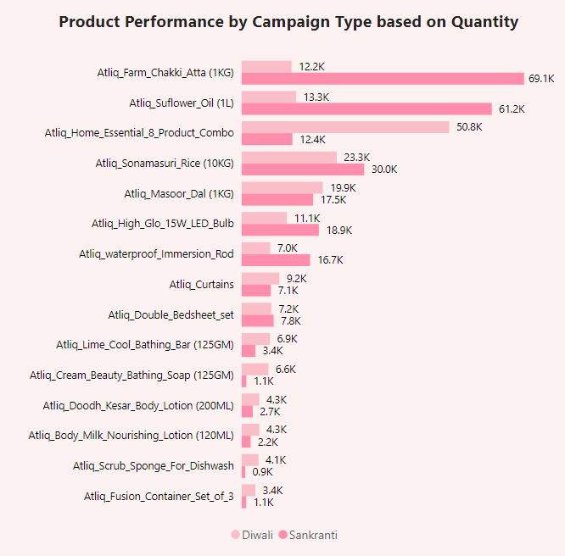
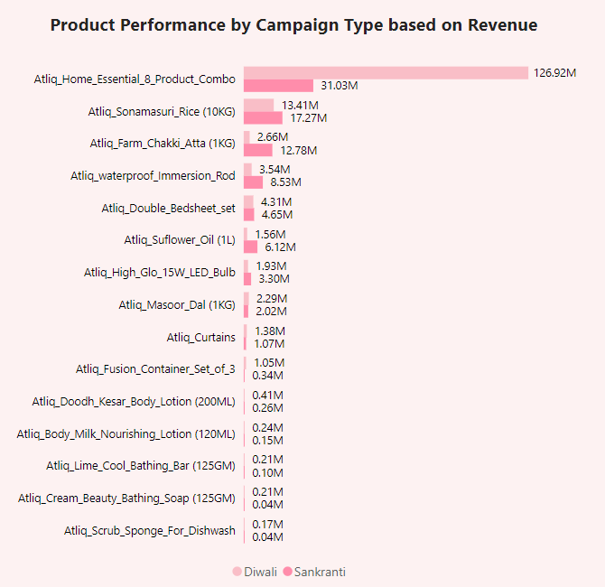
AtliQ
Mart
During Sankranti promotions, Farm Chakki Atta, Sunflower Oil, and Sonamasuri Rice were sold in higher quantities, with quantities sold reaching 69 thousand, 61 thousand, and 51 thousand, respectively.
Similarly, Home Essential 8 Product Combo and Masoor Dal were among the products sold in higher quantities during Diwali promotions, with quantities sold reaching 50 thousand and 19.9 thousand, respectively.
During Diwali promotions, the Home Essential 8 Product Combo emerges as the top revenue generator, contributing to a total revenue of 127 million. Conversely, Sonamasuri Rice and Farm Chakki Atta generated more revenue during Sankranti Promotions, amounting to 17.3 million and 12.8 million, respectively.
Products such as Cream Beauty Bathing Soap and Scrub Sponge for Dishwash generated relatively low revenue, with 0.21 million and 0.17 million, respectively. Interestingly, during Diwali promotions, these products generated more revenue compared to Sankranti promotions.

Slide 29
INSIGHTS
Brief overview of the evaluation and control process, including regular reporting, analysis and adjustment of the marketing plan.

Slide 30
AtliQ
Mart
Diwali Campaign generates the highest revenue, while Sankranti Campaign sees the highest quantity of products sold.
Products with the "500 Cashback" promo type generate the highest revenue, while the "BOGOF" promo type results in the highest quantity of products sold.
Madurai Stores exhibit the highest Incremental Revenue Percentage (IR%) and Incremental Sold Units Percentage (ISU%).
Stores in Bangalore, Chennai, and Hyderabad demonstrate strong performance after promotions.
The Combo 1 category generates the highest revenue, while Home Appliances products are sold in higher quantities.
During Sankranti promotions, grocery and staples products sell the highest quantities.

Slide 31
THANK YOU
LinkedIn : https://www.linkedin.com/in/pavani-bachina-2397321a7/

